Slide 1


Project Presentation On AUTISM SPECTRUM DISORDER PREDICTION USING MACHINE LEARNING TECHNIQUES
VISVESVARAYA TECHNOLOGICAL UNIVERSITY, BELAGAVI
Presented by
DARSHAN GOWDA C 1EE20CS011
BASAVARAJ ANGADI 1EE20CS005
AKSHAY KUMAR P 1EE20CS001
HARISH S 1EE20CS014
Under the guidance of
Prof. POOJA M V
Assistant Professor
DEPARTMENT OF COMPUTER SCIENCE & ENGINEERING
East West College of Engineering, Bengaluru-560064
2023-24

Slide 2
CONTENT
ABSTRACT
INTRODUCTION
LITERATURE SURVEY
PROBLEM STATEMENT
OBJECTIVES
REQIUREMENTS
DESIGN
METHODOLOGY
TEST CASES
RESULTS
CONCLUSION
FUTURE WORK
REFERENCES

Slide 3
ABSTRACT
A neuro-disease known as autism spectrum disorder (ASD) affects a person's ability to engage and communicate with others on a lifelong basis.
Autism is referred to as a "behavioural disorder" since symptoms typically develop in the first two years of life, but it can be diagnosed at any point in one's life.
According to the ASD theory, problems begin in childhood and persist into adolescence and maturity.
The project attempts to explore the potential use of Naive Bayes, Support Vector Machine, Logistic Regression, KNN, Neural Network for predicting and analyzing the ASD problems in a child, adolescent, and adult populations, driven by the rise in the use of machine learning techniques in the research dimensions of medical diagnosis. We make a web interface so that one can utilize the trained ML model effectively.

Slide 4
INTRODUCTION
Autism spectrum disorder (ASD) is becoming an increasingly serious issue for people of all ages today.
The maintenance of the subject's physical and mental health can be considerably helped by early discovery of this neurological condition.
With the increased use of machine learning-based models for illness prediction, it is now possible to identify diseases early based on a variety of physiological and health parameters.
This element encouraged us to become more interested in the identification and examination of ASD disorders in order to develop more effective treatment approaches.
The issue of autism spectrum disease is one that is related to human brain development.

Slide 5
LITERATURE SURVEY
Sl. No. | Title | Author | Year | Techniques | Drawbacks
1 | Machine Learning-Based Models for Early Stage Detection of Autism Spectrum Disorders | Tania Akter, MD.Shahriare Satu, MD.Imran Khan, Pietro Lio | 2019 | Linear Regression (LR) & Naïve Bayes(NB) algorithm | Some classifiers produced biased results despite high accuracy, indicating issues with model reliability.
2 | Machine Learning Classifiers for Autism Spectrum Disorder: A Review | Dadang Eman, Andi W.R Emanuel | 2019 | Support Vector Machine [SVM] | Have limitations such as not thoroughly discussing the challenges in the studies reviewed and not fully exploring how well the machine learning models can be applied in different situations.

Slide 6
Continue……….
Sl. No. | Title | Author | Year | Techniques | Drawbacks
3 | Learning Clusters in Autism Spectrum Disorder: Image-Based Clustering of Eye-Tracking Scanpaths with Deep Autoencoder | Mahmoud Elbattah, Romuald Carette, Gilles Dequen, Jean-Luc Guerin, Federica Cilia | 2019 | K-Means Clustering algorithm | limited sample size of 59 children, lack of external validation for the clustering results, and a focus solely on visual representations of eye-tracking scanpaths without exploring other potential features .
4 | A Machine Learning Approach to Predict Autism Spectrum Disorder | Muhammad Nazrul Islam, Nabila Shahnaz Khan, Kazi Shahrukh Omar | 2020 | Random Forest | The screening application is not designed for the age group below 3 years.

Slide 7
PROBLEM STATEMENT
The current diagnostic methods for Autism Spectrum Disorder (ASD) suffer from subjectivity, variability. This hinders early and accurate detection, leading to delayed interventions with ASD. To address these challenges, our project aims to develop a machine learning-based system that can provide a more objective, scalable approach to ASD detection, improving the overall quality of care and support for individuals on the autism spectrum.

Slide 8
OBJECTIVE
In the proposed project we designed a model to predict the Autism Spectrum Disorder.
This system is capable of providing most of the essential features required to detect ASD.
With the rise of machine learning, artificial intelligence and other relevant fields of information technology, it becomes feasible to automate this process and to save some of the intensive amount of money on scanning that is put into detecting ASD.
Also make the parents to know about their ASD childrens in the earlier stage itself.
Efficient Method For Predicting ASD.

Slide 9
REQUIREMENTS
In this project, we make use of a publicly available 2 imbalanced dataset.
One dataset is used for “Predictive analysis”. The dataset contains around 2000 records.
Another dataset is used for “Image Classification”. The dataset contains around 2600 images.
We are considering “ASD_traits” as a target feature and we treat Autistic as ‘0’ and Non-Autistic as ‘1’.
Software Requirements
Operating System : Windows 64-bit
Technology : Python
IDE : Python IDLE
Tools : Anaconda
Python Version : Python 3
Hardware Requirements
Processor Type : Intel Core TM i5
Speed : 2.4 GHZ
RAM : 8 GB RAM
Hard disk : 80 GB HDD
Input Device : Mouse, Keyboard

Slide 10
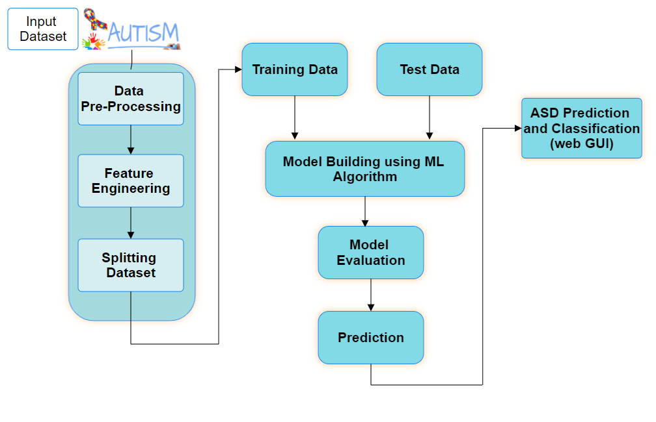
DESIGN
System Architecture

Slide 11
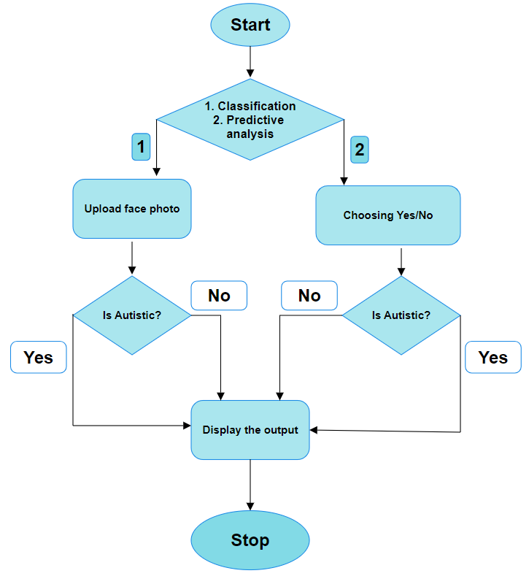
Continue……….
Flow Chart

Slide 12
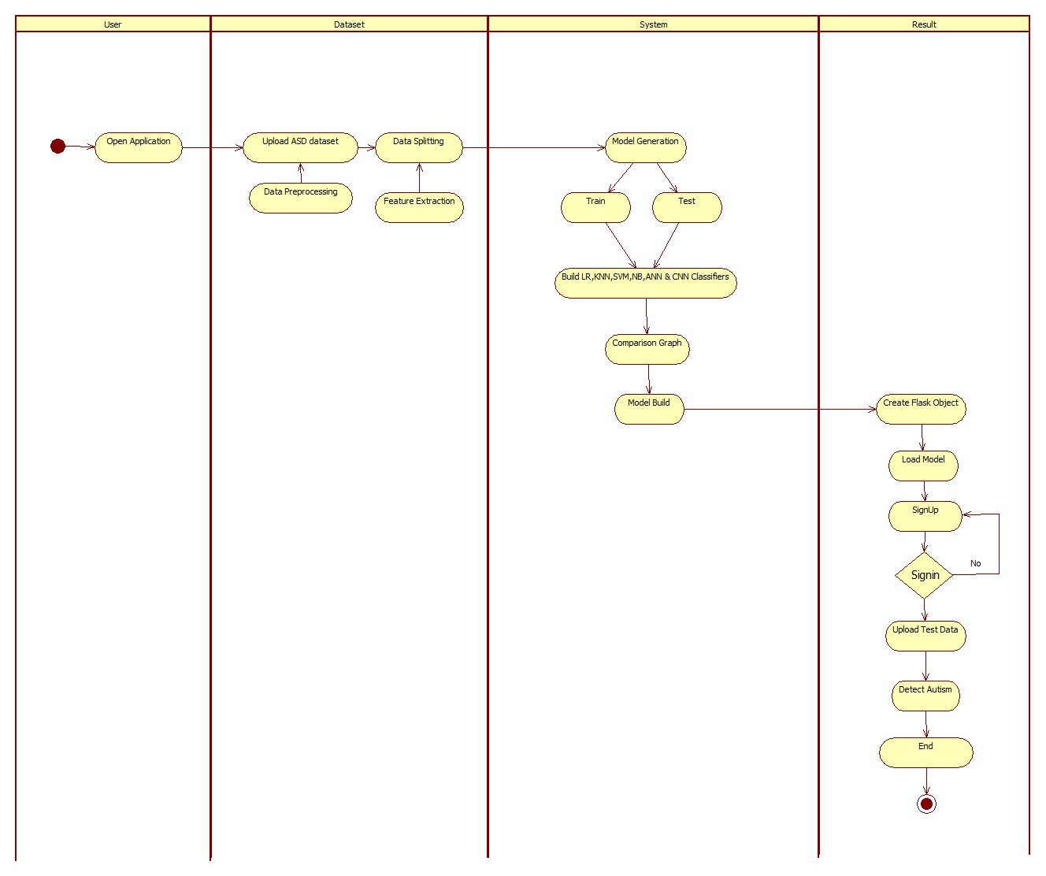
Continue……….
Activity Diagram

Slide 13
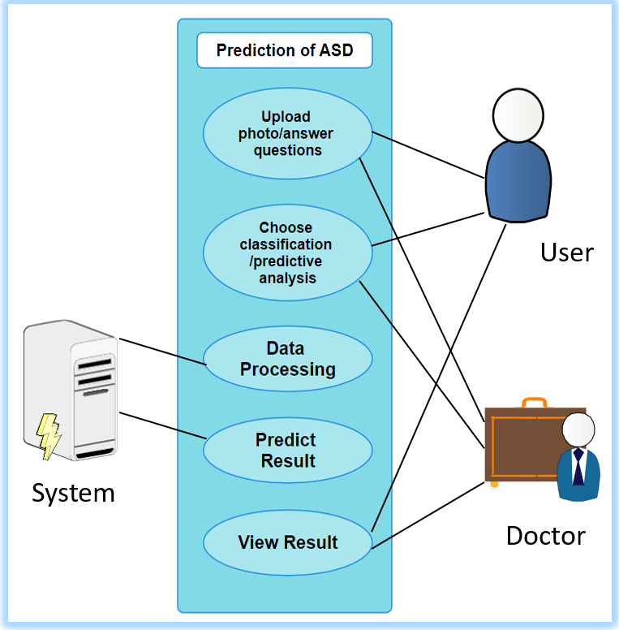
Continue……….
Use-Case Diagram

Slide 14
METHODOLOGY
The Algorithm we used are SVM and VGG-16(CNN).
Random Forest is used for public form and VGG-16 is used for image classification.
SVM - Support Vector Machine (SVM) is a powerful supervised learning algorithm used for classification and regression tasks. It works by finding the hyperplane that best separates the data points into different classes, maximizing the margin between the classes to improve generalization and robustness.
Random Forest –
Random Forest is an ensemble learning method used for classification and regression, which constructs multiple decision trees during training and outputs the mode of the classes for classification or the mean prediction for regression. This method improves predictive accuracy and controls overfitting by averaging multiple decision trees trained on different parts of the same dataset.
VGG-16 – VGG-16 is a deep convolutional neural network architecture known for its depth and simplicity. It consists of 16 layers, including 13 convolutional layers and 3 fully connected layers, making it effective for image classification tasks.

Slide 15
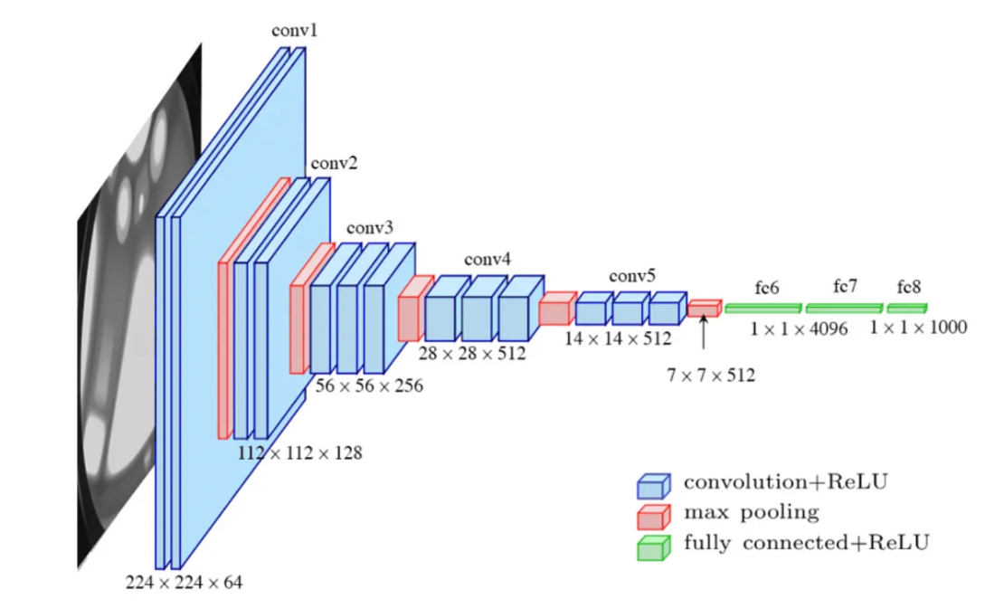
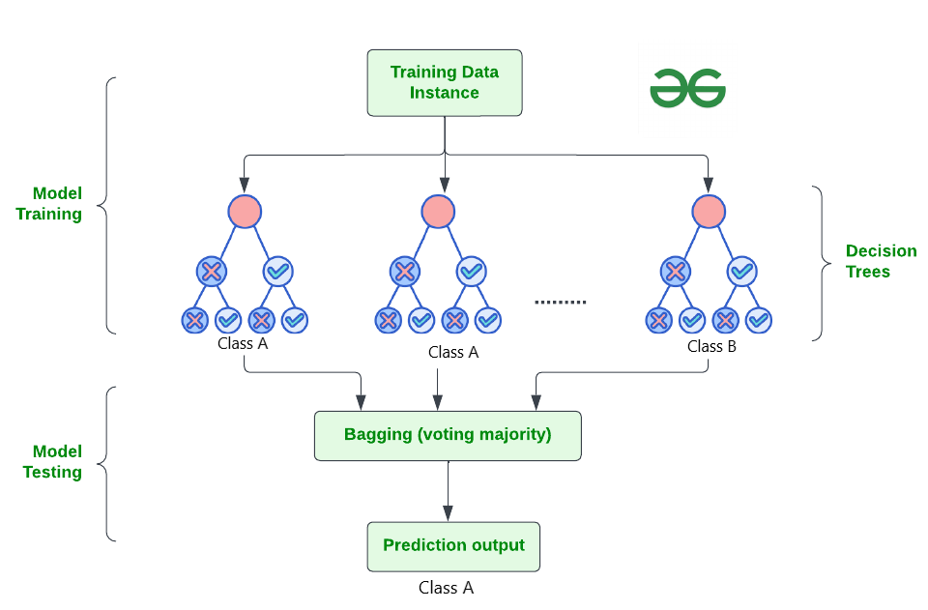
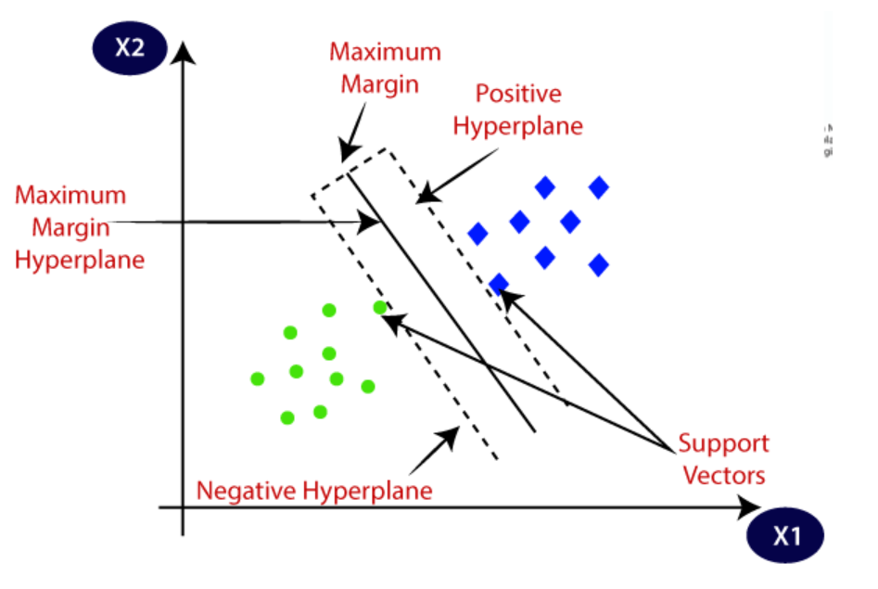




















SVM
Random Forest
VGG 16

Slide 16
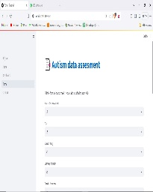
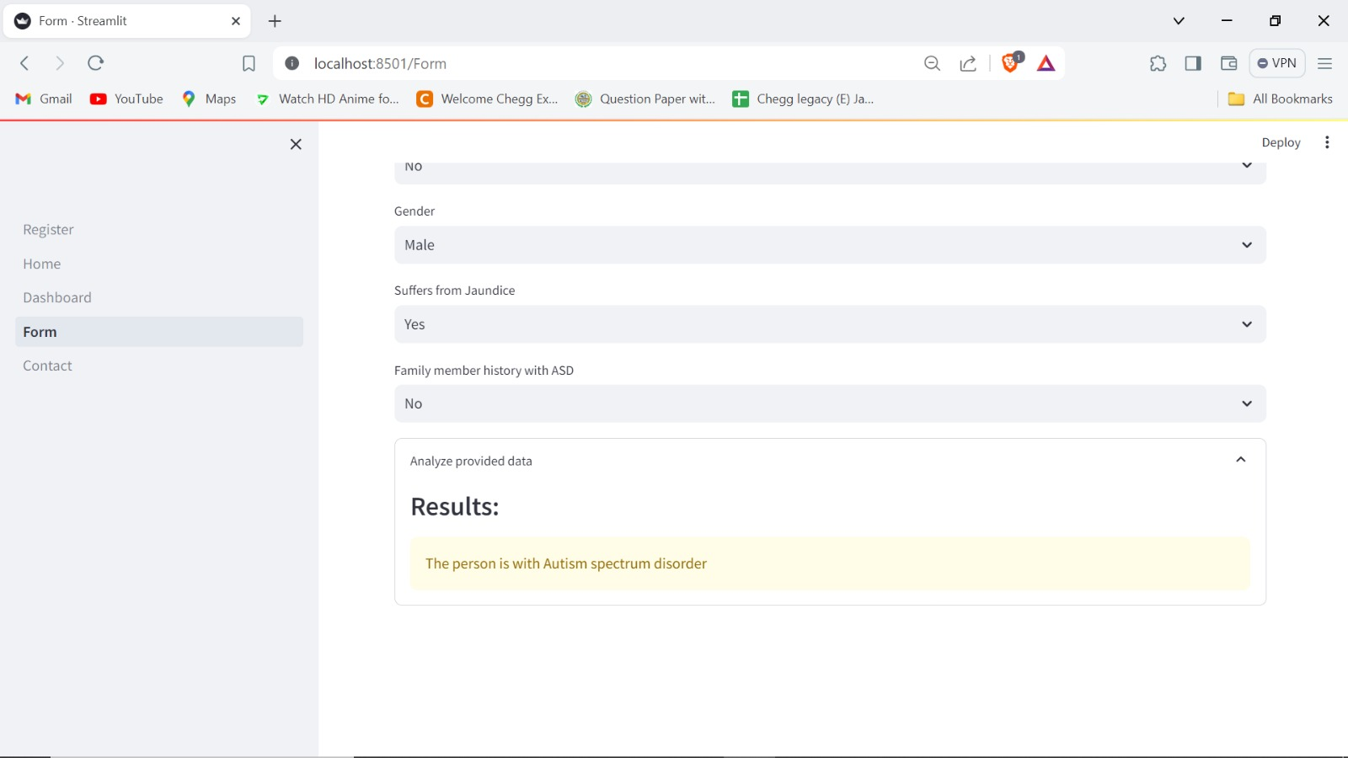
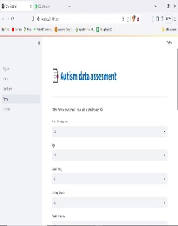
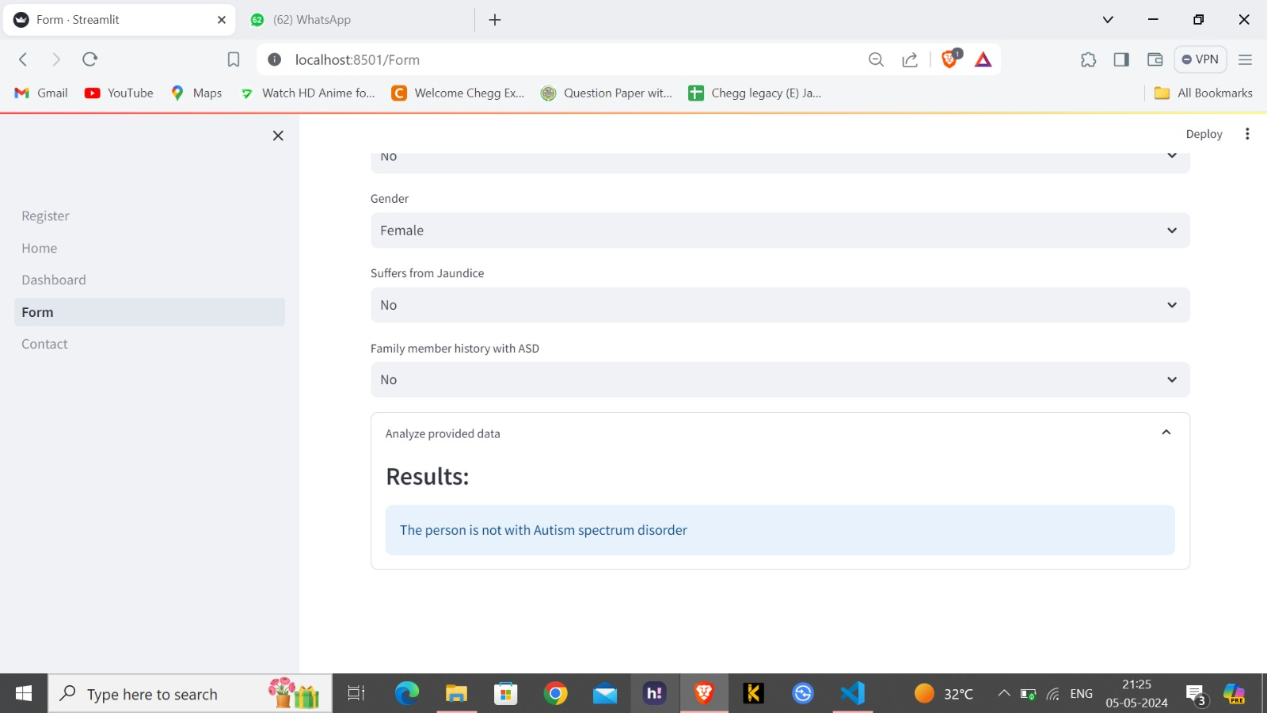
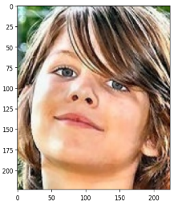

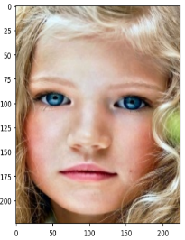
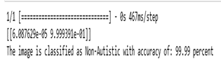
TEST CASES
Test Case ID | Test case Objective | Prerequisites | Steps | Input Data | Expected Output | Actual Output | Status
1 | Input the text | Read text | Enter Number |  | Autism Detected |  | Passed
2 | Input the text | Read text | Enter Number |  | Autism not Detected |  | Passed
3 | Input the image | Read image | Upload image |  | Autism Detected |  | Passed
4 | Input the image | Read image | Upload image |  | Autism not Detected |  | Passed

Slide 17
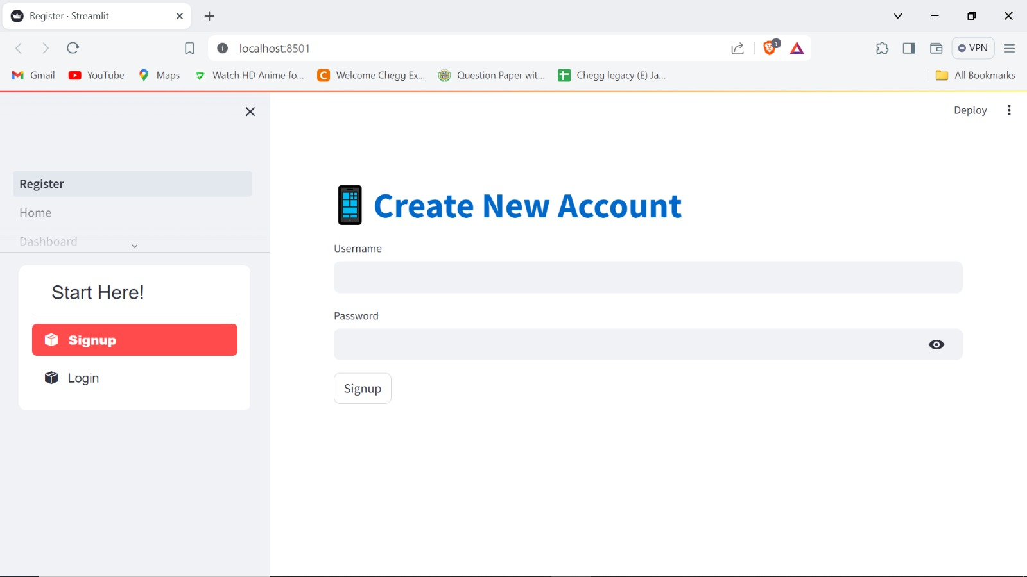
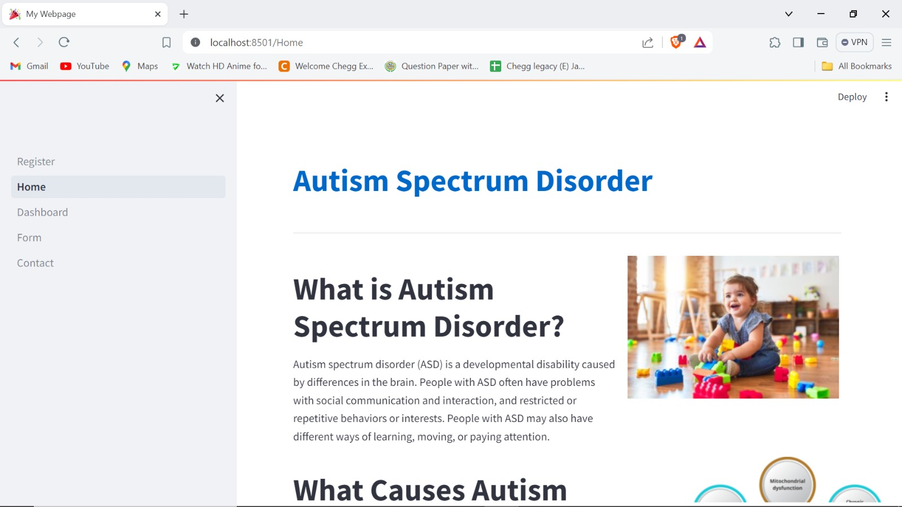
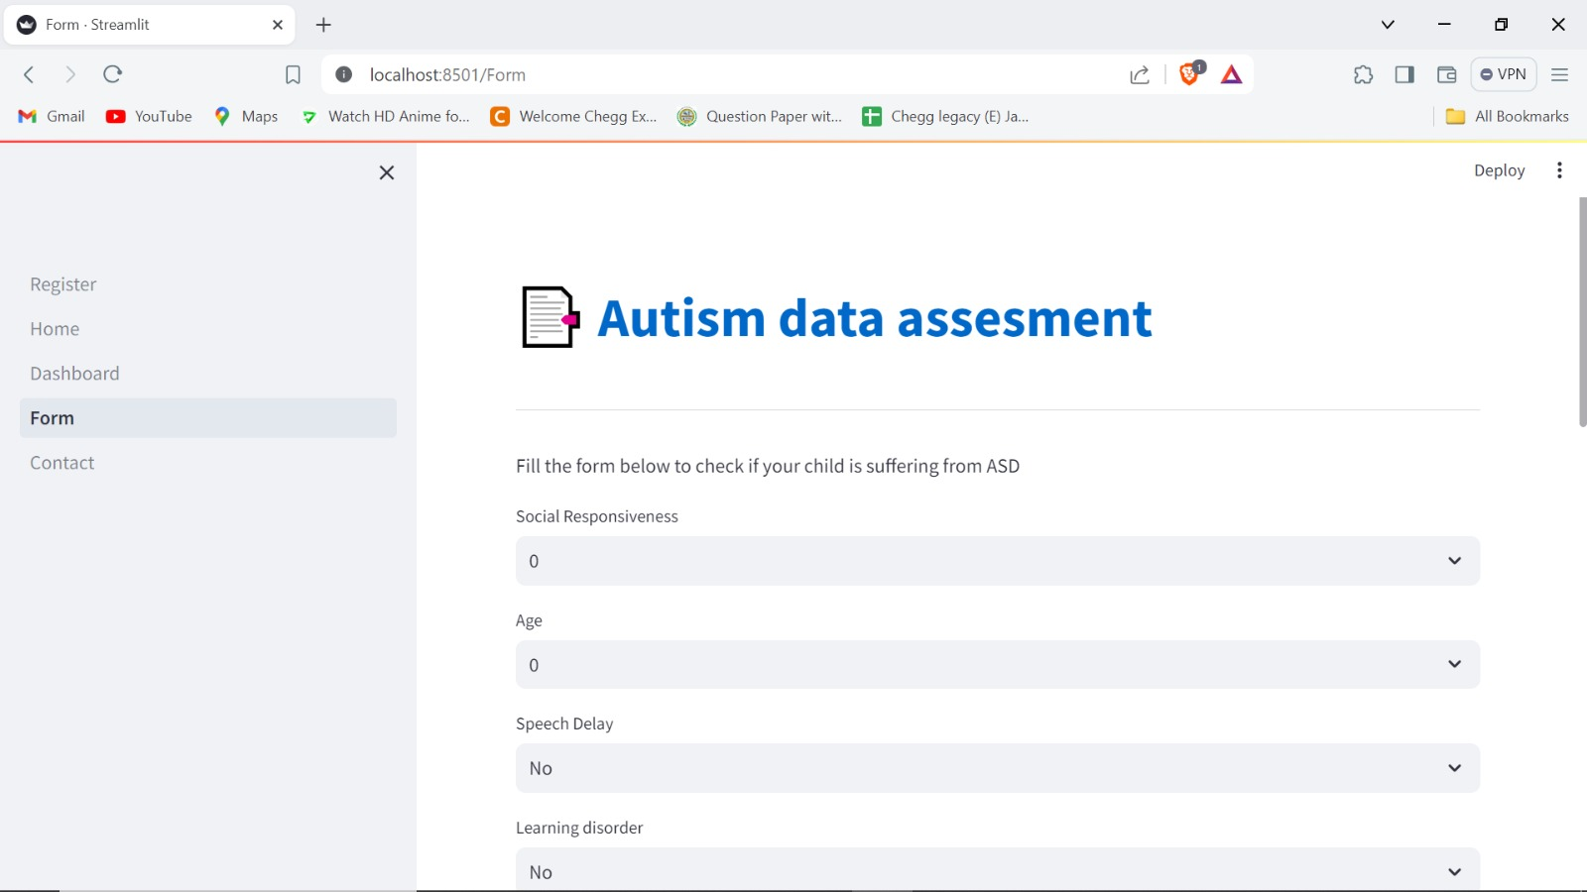
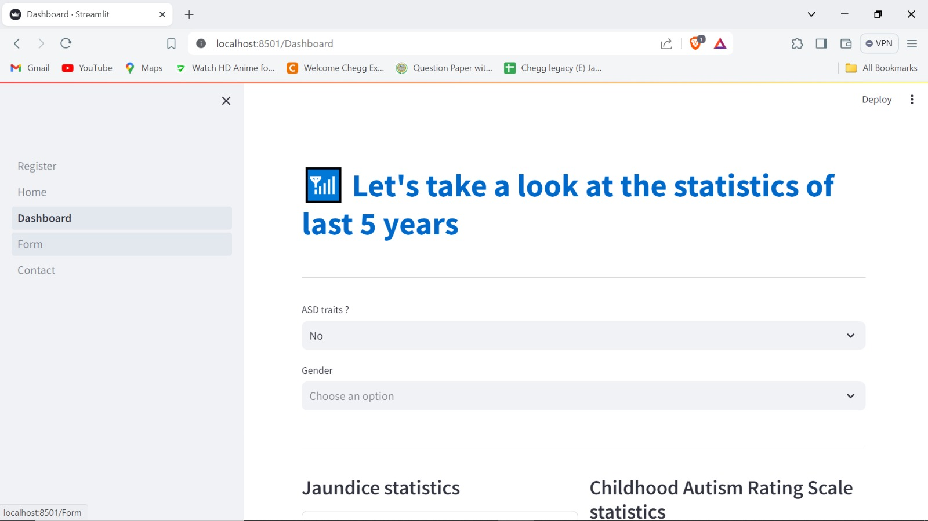
RESULTS

Slide 18
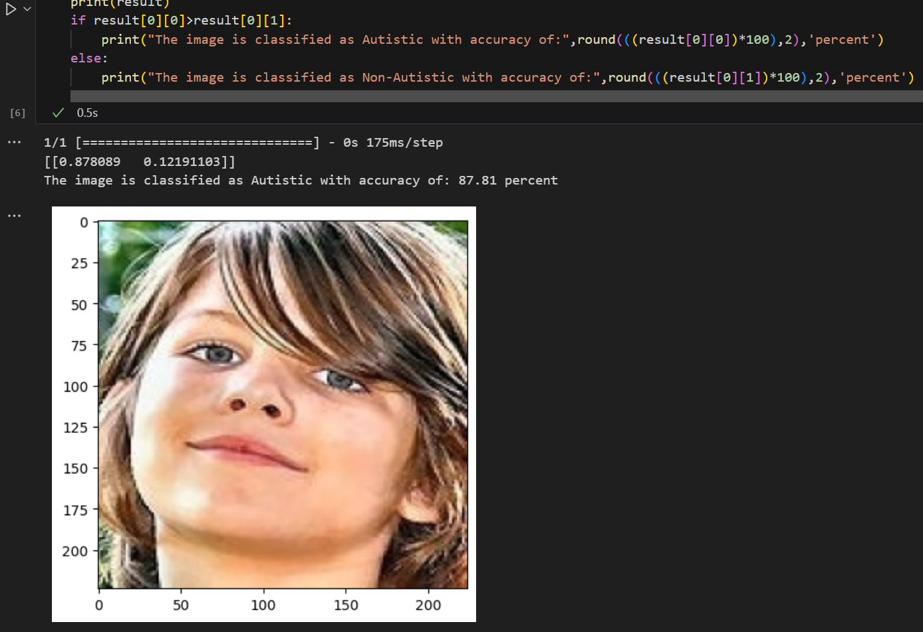
Continue……….

Slide 19
CONCLUSION
Our project represents a significant step towards enhancing the detection and management of Autism Spectrum Disorder (ASD) through the utilization of machine learning techniques.
By addressing the limitations of existing diagnostic methods, we strive to provide a more objective, scalable approach to ASD detection. Through the development of this innovative system, we aim to improve outcomes for individuals with ASD, and ultimately contribute to a better understanding and support system for those on the autism spectrum.

Slide 20
FUTURE WORK
All the algorithms performed almost same with less difference, but we can consider that if these algorithms are trained with some more real-world data then the efficiency and prediction will increase. As we could not reach 100% accuracy even after making many data mining techniques, but we are trying to get more accuracy we will work on combining different algorithms which can give us better accuracy and with respect to data also if we get more data, we can gain more accuracy as learning increases, we will try to decrease False Negatives.
We can be still able to get better results if train models with more data and use genetic algorithms which we will test in our future work. For the Image Classification, as for the future enhancement we can deploy the built vgg16 model to the web so that user will be comfortable in using it.

Slide 21
REFERENCES
Machine Learning-Based Models for Early Stage Detection of Autism Spectrum Disorders by Tania Akter, MD.Shahriare Satu, MD.Imran Khan, Pietro Lio
Machine Learning Classifiers for Autism Spectrum Disorder: A Review by Dadang Eman, Andi W.R Emanuel
Miodovnik, A., Harstad, E., Sideridis, G., & Huntington, N. (2015). Timing of the Diagnosis of Attention-Deficit/Hyperactivity Disorder and Autism Spectrum Disorder. Pediatrics, 136(4), e830–e837.
Thabtah, F. (2020). Machine Learning in Autistic Spectrum Disorder Behavioral Research: A Review and Ways Forward. Informatics, 7(4), 52.
Youtube : Krish Naik, Code Basics, freeCodeCamp

Slide 22
Thank You

